Slide 1
Inference in Datalog

Slide 2
Datalog
Datalog is a subset of the predicate calculus in which inference is particularly simple.
There are two kinds of sentences:
Facts: Atomic formulas.
Rules. Sentences of the form (A₁ ⋀ A₂ ⋀ .. A_{k}) ⇒ Z where the A_{i} and Z are all atomic formulas.
Variables are universally quantified; hence the universal quantifiers may be omitted, as long as you can distinguish between variable and constant symbols. I use upper case for constants and lower case for variables.

Slide 3
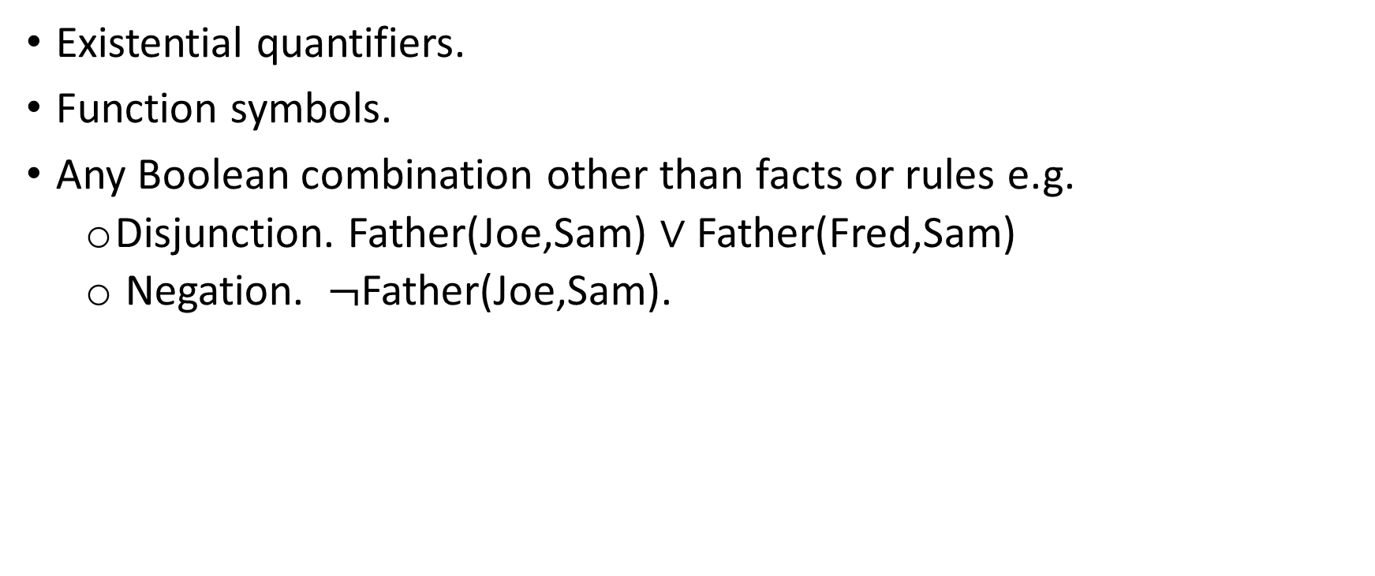
Not allowed in Datalog
Existential quantifiers.
Function symbols.
Any Boolean combination other than facts or rules e.g.
Disjunction. Father(Joe,Sam) ∨ Father(Fred,Sam)
Negation. $¬$Father(Joe,Sam).

Slide 4
Sample Datalog knowledge base.
Predicates:
Parent(x,y). x is a parent of y.
Child(x,y). x is a child of y.
Grandparent(x,y). x is a grandparent of y.
Anc(x,y). x is an ancestor of y.
Sibling(x,y). x is a sibling of y.
Constant: Elizabeth, Charles, Andrew, William, Beatrice.

Slide 5
Knowledge base
Rules
Parent(x,y) ⇒ Child(y,x).
Child(y,x) ⇒ Parent(x,y).
Parent(x,y) ⋀ Parent(y,z) ⇒ Grandparent(x,z).
Parent(x,y) ⇒ Anc(x,y).
Parent(x,y) ⋀ Anc(y,z) ⇒ Anc(x,z).
Parent(x,y) ⋀ Parent(x,z) ⇒ Sibling(x,z).
Facts:
7. Parent(Elizabeth,Charles)
8. Parent(Elizabeth,Andrew)
9. Parent(Charles,William)
10. Parent(Andrew,Beatrice)

Slide 6
Inference: Forward chaining
Inference in Datalog is a combination of two ideas.
Propositional modus ponens:
Given fact P and rule P ⇒ Q, infer fact Q.
More generally, given facts P₁, P₂ … P_{k} and rule P₁⋀ P₂ ⋀ … ⋀ P_{k} ⇒ Q,
infer fact Q.
Universal instantiation
Given ∀x α(x), infer α(τ) for any term τ.
If everything is α, then any particular thing is α.

Slide 7
Inference: Universal Instantiation + Modus Ponens
In principle:
Given
(7) Parent(Elizabeth,Charles).
(1) Parent(x,y) ⇒ Child(y,x)
Step 1: Use universal instantiation on (2) to get
(1’) Parent(Elizabeth,Charles) ⇒ Child(Charles,Elizabeth)
Step 2: Use modus ponens on (1) and (2’) to get
(11) Child(Charles,Elizabeth)

Slide 8
Combining these into a single step
We could have chosen any values to substitute for x,y in (2):
(1) Parent(x,y) ⇒ Child(y,x)
(1’) Parent(NYU,MonaLisa) ⇒ Child(MonaLisa,NYU)
Why did we choose x→Elizabeth and y→Charles? Because we foresaw that if we did that, then we would be able to apply modus ponens.
We unified the fact (7) Parent(Elizabeth,Charles) with the left hand side of rule (1) Parent(x,y) under the substitution {x→Elizabeth, y→Charles}

Slide 9
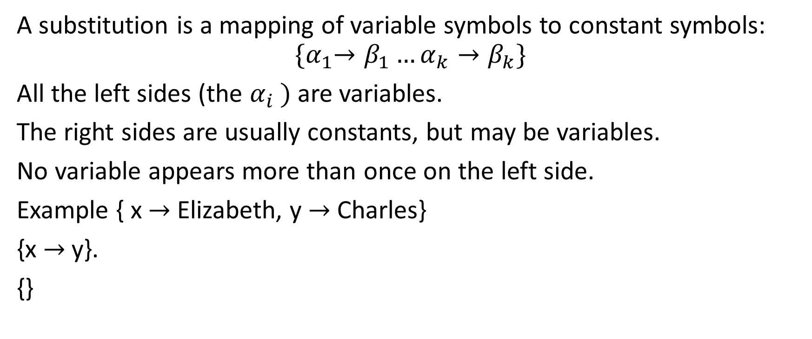
Substitutions
A substitution is a mapping of variable symbols to constant symbols:
$${\{α}_{1}→β_{1}…α_{k}→β_{k}\}$$
All the left sides (the $α_{i} )$are variables.
The right sides are usually constants, but may be variables.
No variable appears more than once on the left side.
Example { x → Elizabeth, y → Charles}
{x → y}.
{}

Slide 10
Applying a substitution
To apply a substitution to a Datalog sentence, replace every occurrence of the variables on the left side with the corresponding term on the right side.
Applying the substitution { x → Elizabeth, y → Charles}
to the sentence Parent(x,y) ⇒ Child(y,x)
gives the sentence Parent(Elizabeth,Charles) ⇒ Child(Charles,Elizabeth)

Slide 11
Unification
To unify a collection of facts F₁ … F_{k} with a rule Q₁ … Q_{k} ⇒ P, you find a substitution σ such that σ(F₁) = σ(Q₁) … σ(F_{k}) = σ(Q_{k}). This is called unifying F₁ … F_{k} with Q₁ … Q_{k}.
(Usually all the variables are in the Q’s, but occasionally in the F’s.)
For instance if you have facts (7) Parent(Elizabeth,Charles) and
(9) Parent(Charles,William) and the rule
(3) Parent(x,y) ⋀ Parent(y,z) ⇒ Grandparent(x,z)
you unify the facts with the left hand side of the rule using the substitution σ = { x → Elizabeth, y → Charles, z → William}

Slide 12
Inference: Forward chaining step
(7) Parent(Elizabeth,Charles)
(9) Parent(Charles,William)
(3) Parent(x,y) ⋀ Parent(y,z) ⇒ Grandparent(x,z)
σ = { x → Elizabeth, y → Charles, z → William}
Apply σ to (7) and (9) – don’t change.
Apply σ to (3) gives
(3’) Parent(Elizabeth,Charles) ⋀ Parent(Charles,William) ⇒ Grandparent(Elizabeth,William).
Now apply modus ponens to get (12) Grandparent(Elizabeth,William).
But actually there’s no need to write out (3’); you can go straight from (7), (9), (3) and σ to (12).

Slide 13
Forward chaining algorithm
FC(SF: set of Datalog facts; R: a set of Datalog rules) {
repeat {
find facts F₁ … F_{k} in SF and a rule Q₁ … Q_{k} ⇒ P in R such that
F₁ … F_{k} unify with Q₁ … Q_{k} under substitution σ;
P’ = σ(P);
if (P’ is not in SF) add P to SF;
} until (no new facts can be derived)
return SF;
}

Slide 14
Notes
Once a fact has been derived, it can be used in further inferences.
A rule doesn’t get “used up”; it can be used any number of times.
The algorithm terminates, because there are only finitely many possible facts for a finite vocabulary of predicates and constants.

Slide 15
Notes
Under rare circumstances, there can be more than one way to unify a set of facts with a rule. For instance if you have the facts
H(A)
H(B)
H(x) ⋀ H(y) ⇒ K(x,y)
then you can use the substitution σ = { x → A, y → B} to derive K(A,B)
and you can use the substitution σ = { x → B, y → A} to derive K(B,A)

